Slide 1
Carbon emission prediction
APAI PROJECT WORK A.Y. 2023/24
MASTER DEGREE IN ARTIFICIAL INTELIGENCE, UNIVERSITY OF BOLOGNA
FATEMEH BOZORGI
FATEMEH.BOZORGI@STUDIO.UNIBO.IT

Slide 2

Green Computing
Green computing, also called sustainable computing, is the process of developing and optimizing computer chips, systems, networks, and software in such a manner that can maximize efficiency by utilizing energy more efficiently and minimizing the negative environmental influence on the surrounding.
S. G. Paul et al., "A Comprehensive Review of Green Computing: Past, Present, and Future Research," in IEEE Access, vol. 11, 2023

Slide 3
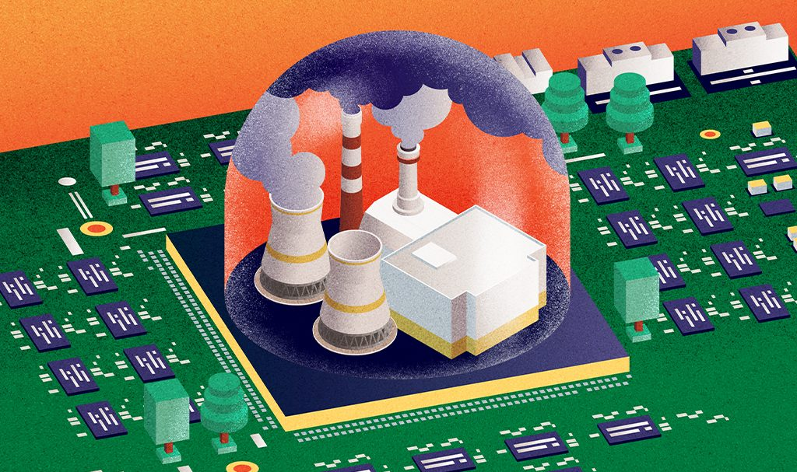
There are numerous ways in which large computing facilities impact the environment: energy production, hardware manufacturing, long-term storage management, cooling, maintenance, etc.
One of the most significant environmental impacts of large computing facilities is the emission of carbon dioxide (CO2) and other greenhouse gases into the atmosphere.

Slide 4
Comparing carbon footprint in hpc centers and other sectors
Data centers generate the same amount of carbon emissions as global airlines.
Recent studies estimate that computing and communication technology sectors are responsible for 2% of global carbon emissions.
Transport accounts for around one-fifth of global carbon dioxide (CO₂) emissions — 24% if we only consider CO₂ emissions from energy.
Aviation — while it often gets the most attention in discussions on action against climate change — accounts for 11.6% of transport emissions. It emits just under one billion tonnes of CO₂ each year — around 2.5% of total global emissions.
Khosravi, Atefeh, Saurabh Kumar Garg, and Rajkumar Buyya. "Energy and carbon-efficient placement of virtual machines in distributed cloud data centers." Euro-Par 2013 Parallel Processing: 19th International Conference, Aachen, Germany, August 26-30, 2013. Proceedings 19. Springer Berlin Heidelberg, 2013.
https://ourworldindata.org/co2-emissions-from-transport

Slide 5
environmental effect of CO2
Carbon emissions contribute to global warming by trapping heat in the atmosphere, leading to climate change and its associated impacts such as extreme weather, sea level rise, and disruptions to ecosystems.
Due to the serious problems that carbon emission has to the environment, we have to reduce the carbon footprint in all the involved sectors included data centers.
The science is clear: sustainable development and climate action are inseparable (nature.com)

Slide 6
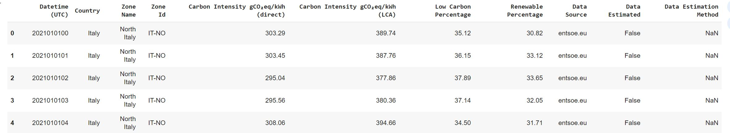
data
From 2021 to 2023, in a data center, each hours, the amount of data has been recorded and data set is created as shown in the picture.
For this project we consider only one column of “Carbon Intensity gCO₂eq/kWh (direct)”.

Slide 7
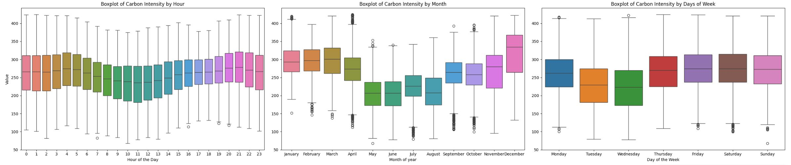
Data exploration
After some data processing, we found some patterns in carbon emission during these three years.
In some particular hours of day like at 11 or on Thursday and Wednesday or on May and June the carbon emission are lower than other times.
So we can do some predictions to reduce the carbon emission based on the time that the operation will be done.

Slide 8
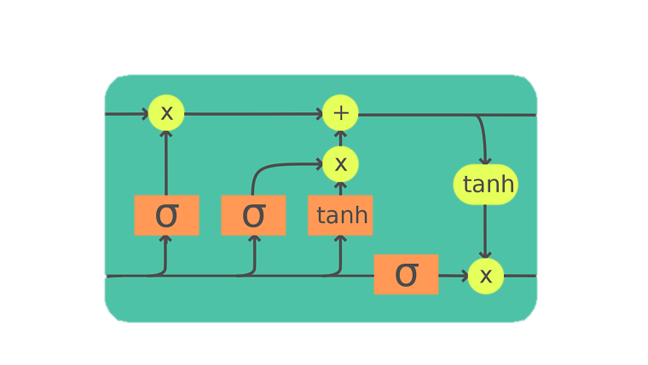
Idea
The purpose of this project is to build a predictor that when a task is received for doing something, the system decide to do it now or postpone it to another time to reduce the carbon.
The architecture that is used as predictor is LSTM and it is implemented in pytorch.

Slide 9
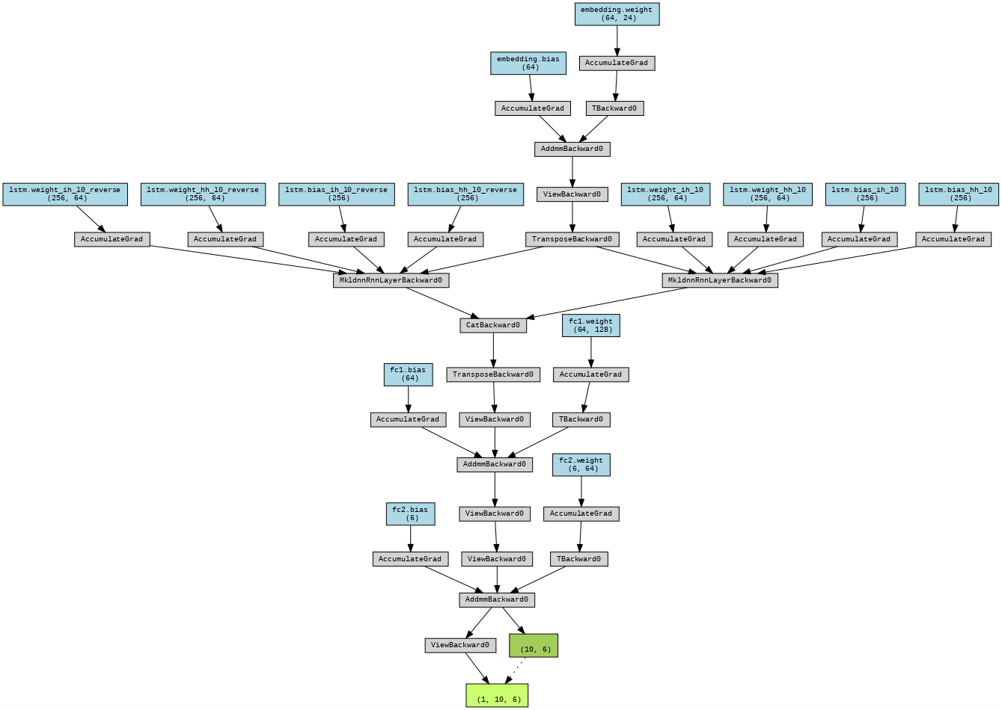
This neural network consists of an embedding layer that first transforms the input into a dense representation.
Following this, a bidirectional LSTM layer captures temporal dependencies in both forward and reverse directions.
The network then uses two fully connected layers to further process the information and produce the final output.
Additionally, it employs batch normalization to ensure stable and efficient training. The model is flexible, allowing for adjustments in layer sizes and the use of dropout for regularization.

Slide 10
Two different approaches
For the architecture we consider two different set up:
Make the data set in a way that the model receive the 24 hours and then predict the next 6 hours
The other approach is the model take the last year data and predict the next month

Slide 11
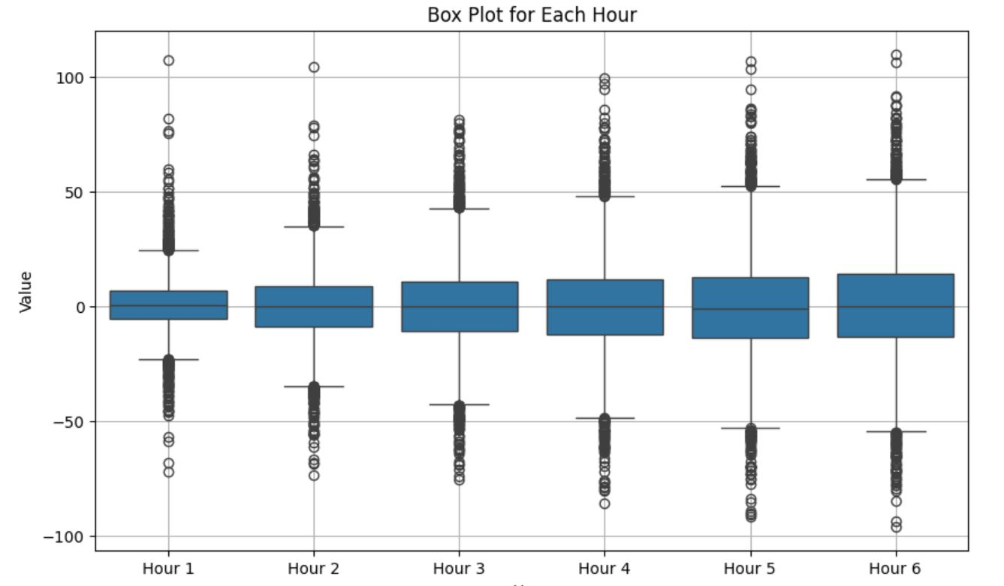
First approach
As it can be expected the model predicts the first hour better than the later ones and here is the errors for each hour calculated on the test set:

Slide 12
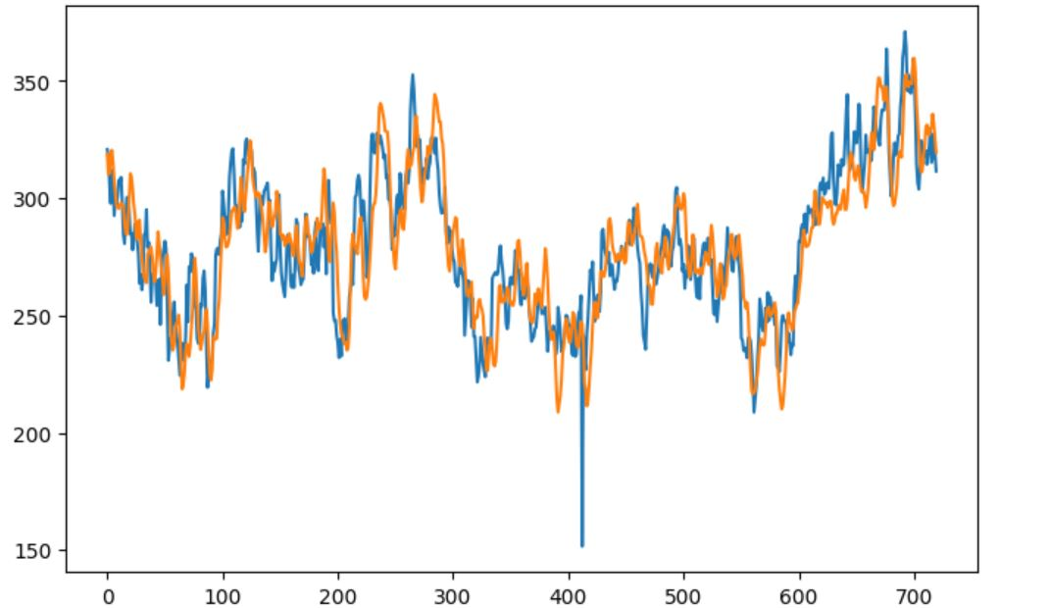
Second approach
The second approach that take a year and predict the next month is more accurate than the previous model and as you can see the plot below show the real values(blue line) and predicted one(orange) for a month in test set.

Slide 13
Future works

Slide 14
Thank you

